Slide 1




#RintisKarirImpian
Portofolio - Intensive Bootcamp
Data Visualisation 1: Basic Data Viz + Project
Owner: Adin Nugroho
Build your skill and portfolio via myskill.id/bootcamp

Slide 2

Imagine you’re a Data Analyst preparing to present your insights to an audience.
Main task
Please create a minimum of 3 data visualization based on this Sales Data
Side task #1 Also create a storyline based on your visualization of your findings (it could be all three or it could be only one of your visualization).
Side task #2 Please create a dashboard based on one of your data visualization.
#RintisKarirImpian

Slide 3
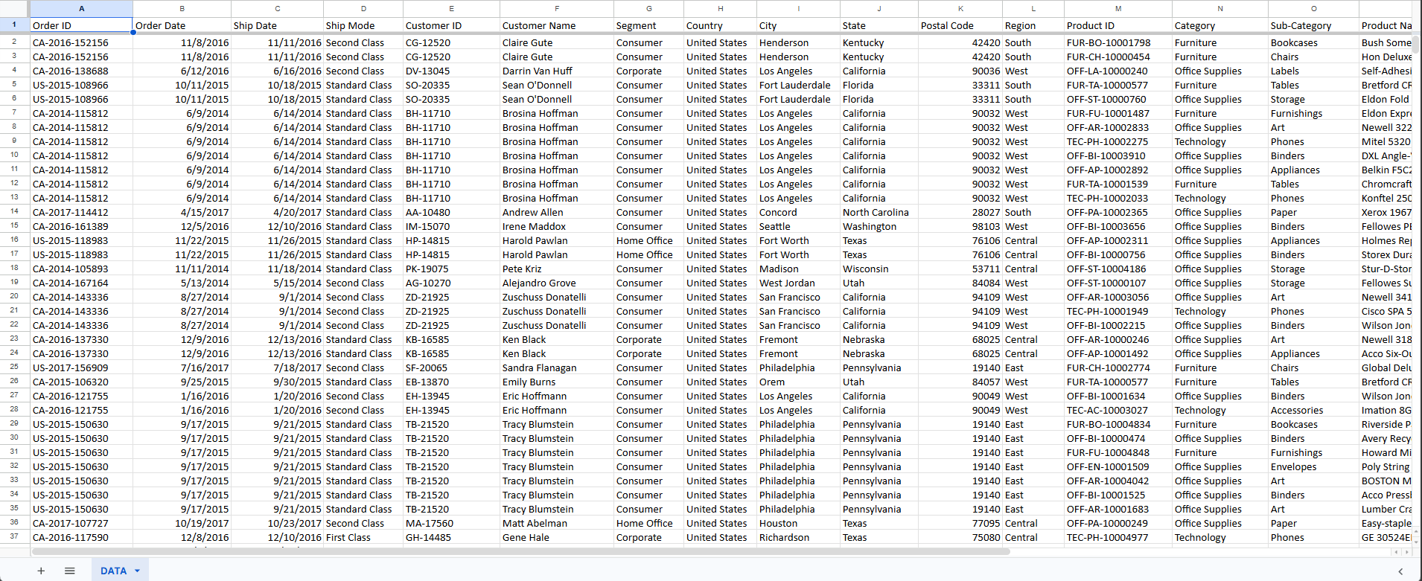
Raw Data
Data already cleaned and well-formatted
#RintisKarirImpian

Slide 4
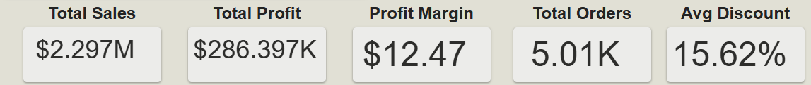
Business Overview
Analysis period including sales performance by O-Store during 2014-2017. Overall this company have $2.29 Million Revenue with $286K profit earnings.
Insight:
Sales and profit have consistantly increased from year the year.
Average discount earns 15.62%.
Profit margin get less value than average discount offered.
#RintisKarirImpian

Slide 5
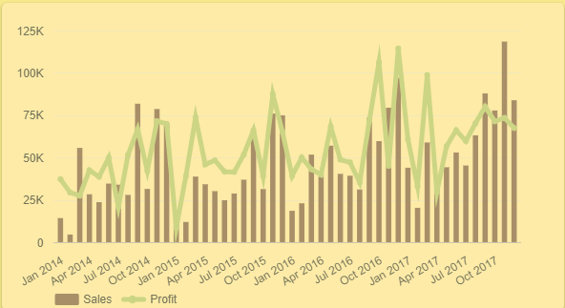
Sales Trend Analysis
Sales growth from year to year has positively moved.
But profit has not kept pace with sales, which is Increased revenue has not always been accompanied by increased profits.
this indicates there are other factors such as discounts or products compositions that affect profitability
Short insight:
Current business growth is driven more by transaction volume than margin efficiency.
#RintisKarirImpian

Slide 6
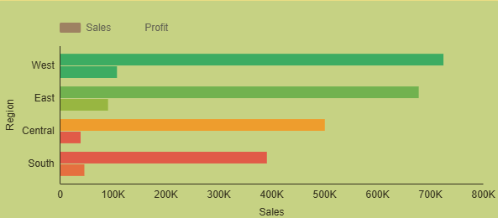

Regional Performance
Based on regional sales performance, the western and eastern regions achieved the highest sales.
Conversely, the central and southern regions had the lowest sales revenue.
This indicates that business performance is concentrated in certain regions, creating opportunities to generate more revenue in other regions.
#RintisKarirImpian

Slide 7
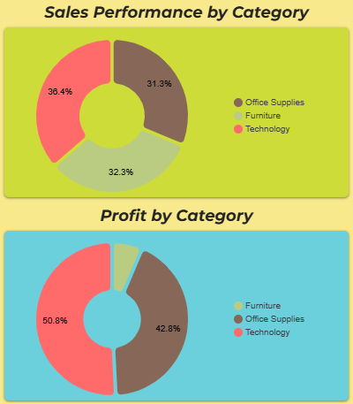
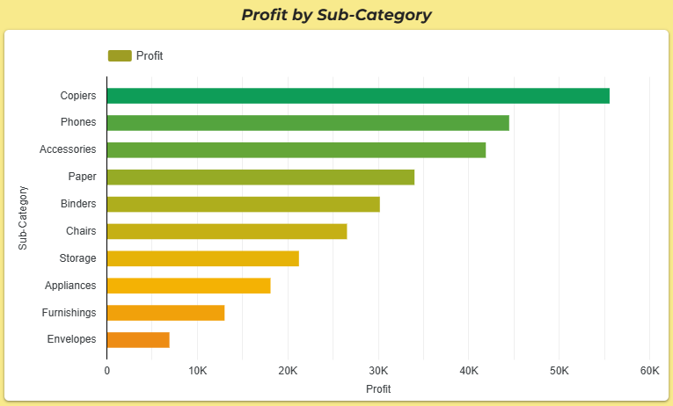
Product Performance
Technology has the most highest sales and profit performance than other categories.
looking in more detail at the sub-category level, products such as Copiers and Phones are the main profit contributors.
Not all products provide the same business value, making product strategy a critical factor in increasing profits.
Focusing on high-margin products has the potential to increase profits without significantly increasing sales volume.
#RintisKarirImpian

Slide 8
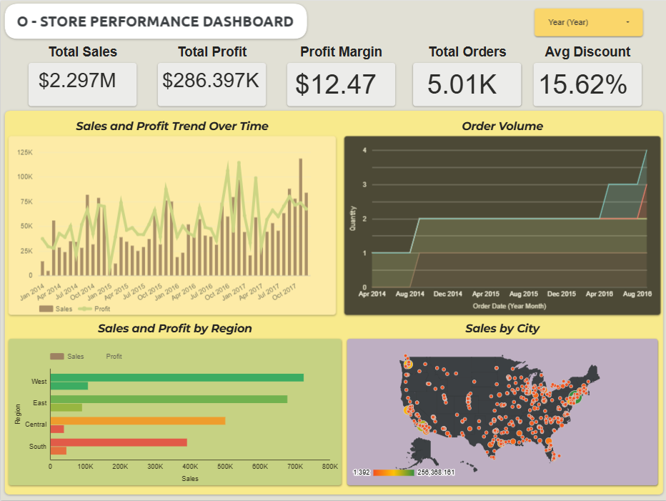
Dashboard
#RintisKarirImpian

Slide 9
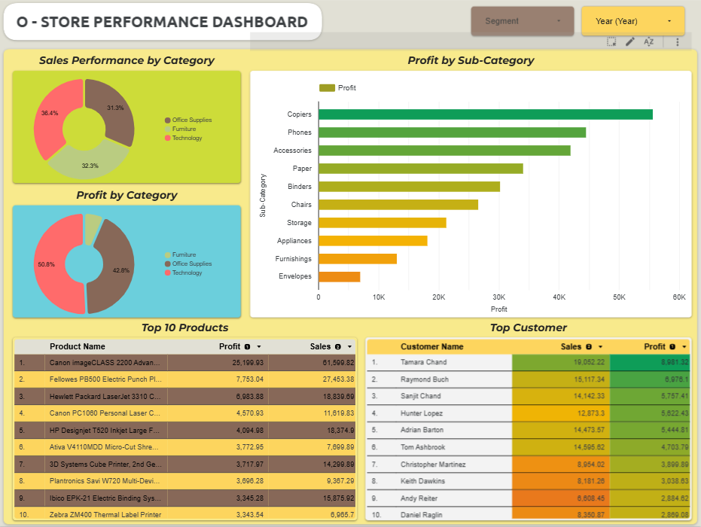
Dashboard
https://lookerstudio.google.com/reporting/c2976ba7-6bb4-4854-aeae-02cfc922c8ad
#RintisKarirImpian

